Slide 1
18CSP107L
Minor Project
Second Review (14-10-2023)
Panel : 37
Panel Head : Dr. S.Pradeep (101242)
Panel Member: Dr. K.Priyadharshini (103105)
Batch Id: 550
Student 1 : Ayush Srivastava (RA2011003010759)
Student 2 : Hansa Verma (RA2011003010799)

Slide 2
Index
Project Title & Abstract 3
Literature Review 4
Comparison of Existing Methods with merits and demerits 7
Challenges to address 10
Problem Statement and Objectives 12
Architecture / Block Diagram of the proposed model 13
Modules Description and Implementation (25%) 14
Intermediate Results and Discussion 18
Screenshots 19
References 22

Slide 3

AgroNexa : Agriculture Reimangined
India's agriculture sector holds a pivotal position in its economy, society, and global landscape. India's agriculture sector contributes significantly to the nation's economy. It employs a substantial portion of the population and plays a crucial role in ensuring food security. With approximately 58% of the rural workforce engaged in farming activities, agriculture contributes around 15% to India's Gross Domestic Product (GDP). The sector's productivity and growth are central to maintaining macroeconomic stability and rural development Agriculture also serves as a safety net against economic uncertainties, particularly for rural communities. Despite its significance, India's farming sector faces pressing challenges, including yield gaps, low mechanization levels, and market access barriers. Nonetheless, there are opportunities to modernize the sector through technology adoption, improved irrigation methods, crop diversification, and better supply chain management. These efforts can lead to increased productivity, income generation, and enhanced resilience in the face of global uncertainties.

Slide 4
Literature Review
[1]Spry Farm: A Portal for Connecting Farmers and End Users
The portal helps the farmers in registering themselves easily and selling their produce. The farmers can gain more profit than usual by using the web portal since it forms a direct connect to the customers. Removing the intervention of the middlemen. The total sale and the earned profit for the sold products, and customer needs are better known by the farmers through the portal. This would overall give a clear idea to the farmer as to what the customer requirements are and to how to grow only the required crops and needed investments for the same as alike. The max-prior algorithm used helps in allocating the highest requirement customer to the farmers to gain better profit. It also helps the farmers in selling their produce quicker. Thus, by this portal the farmers gain more profit hence increasing the country’s economy.

Slide 5
Krishi - A web-based portal for farmers has been created which provides direct suggestions to the farmers regarding the information about various crops, diseases in crops, rates of various crops, weather forecasting based on the crop’s topography and available government schemes to uplift the lives of the farmers [2]
An alternate approach for selling of farm produce has been constructed wherein the parameters are differentiated based on the traditional methods of agro-industry and the present methodology. A survey was made on the E-mandi online platform by (Sheetal Bhagwat et al) for buying and selling of products directly. The preference of the customer is determined based on the mathematical modelling and preferential evaluation of the buyer. This preference is then given as an input to the Naïve Bayes algorithm and this determines the customer needs. A mobile application is used for viewing the data obtained from the cloud after calibration [3].

Slide 6
Comparison Of Existing with Merits and Demerits

Slide 7
Existing Method
The existing method consists of generic buy, store, repair processes where the farmer needs to buy the equipment he needs , store it in proper place and repair it when it breaks down.
This is economically very challenging for a marginalized farmer community as they already have heavy debts on them and hardly break even after selling their produce.
Usually to buy equipment , these farmers pick up credit through private lenders who charge exorbitant interest rates and the farmers gets trapped in dangerous debts traps.
This debt traps in many cases turn out suicidal for farmers as seen in newspapers.
Merits: Permanent Ownership, 24x7 availability.
Demerits: Extra storage and maintenance cost, Debt traps.

Slide 8
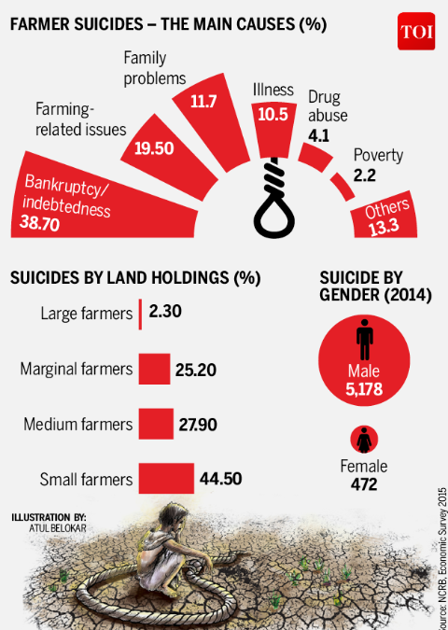
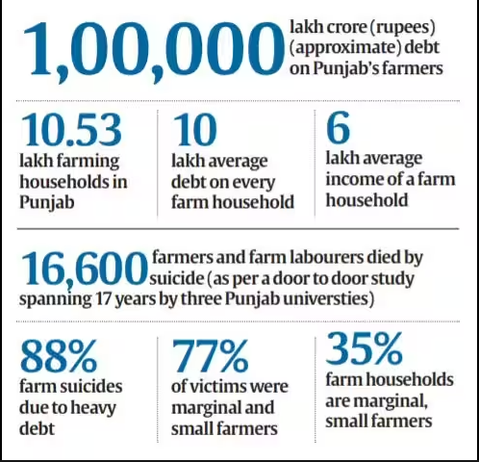
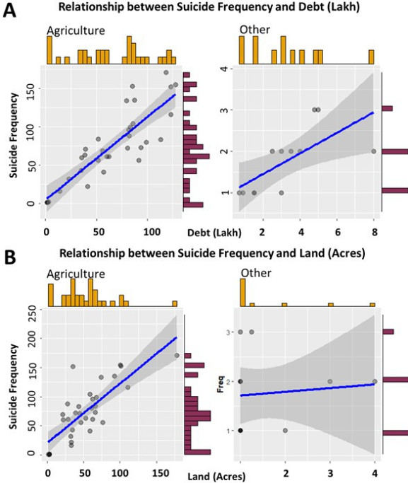

Slide 9
Proposed Method
The proposed method comprises of a web-based application called “AgroMates”, designed as a C2C solution for farm equipment rentals.
Here, a farmer can rent and lease farming equipment at affordable rates and hence save a lot of money on buying equipment’s himself.
Html, CSS, JavaScript and MongoDB will be used to develop the application.
Additionally, a recommendation system will be implemented to suggest the farmer best listings from the ads that meet his requirement and budget.
Algorithms such as Naïve Bayes, SVM , K-nearest Neighbour ,Random Forest and Boosting will be used to test accuracy of recommendation system.
This portal will in-short, Improve economics and finances of these marginalized farmers.

Slide 10
Challenges To Address
Local level implementation
Government policies
Ease of use
Logistic and transfer process
Rent collection and payment

Slide 11
Problem Statement and Objectives

Slide 12
Problem Statement
Implement a renting portal for farm equipment's and test its efficacy in improving the financial conditions of farmers.
Objectives
1.Developing the portal
2.Developing the recommendation system.
3.Analyzing its accuracy
4.Analyzing the effectiveness of the portal
5.Identifying and Solving the intermediary obstacles

Slide 13
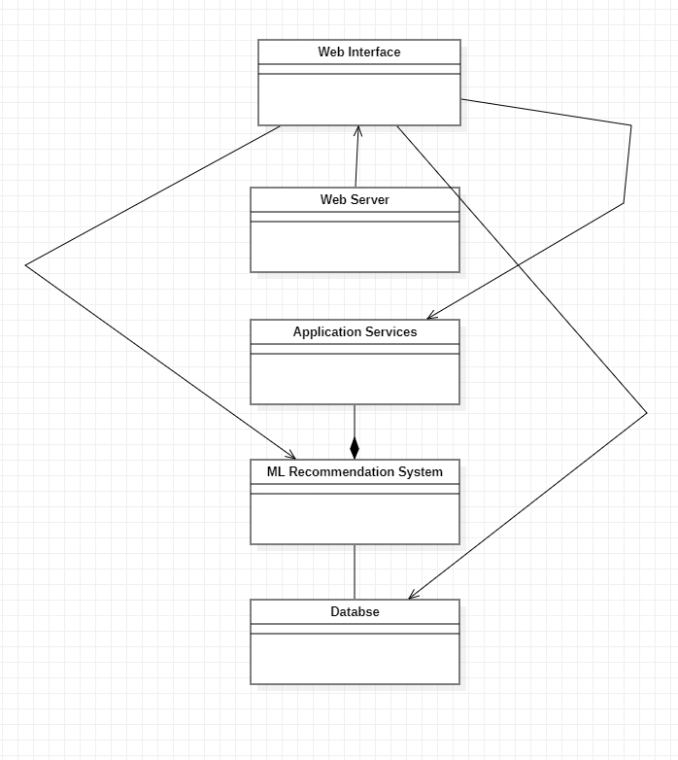
Architecture / Block Diagram of the proposed model 1.Web Interface: HTML,CSS,JAVASCRIPT,UI 2.Web Server: Node.js 3.Application services: Business requirements 4.Ml recommendation system: naïve bayes, svm, random forest algo, k – nearest neighbour, boosting. 5.databse : sqlite3, mysql, mongodb.

Slide 14
Modules Description and Implementation (25%)
1.HTML: Used to design basic skeleton of our portal.
2. CSS: Styling our portal to look more presentable.
3.Javascript: For taking and returning queries
4.SK-learn: To train and test accuracy of dataset.
5.MongoDB: Create database and manipulate it.

Slide 15
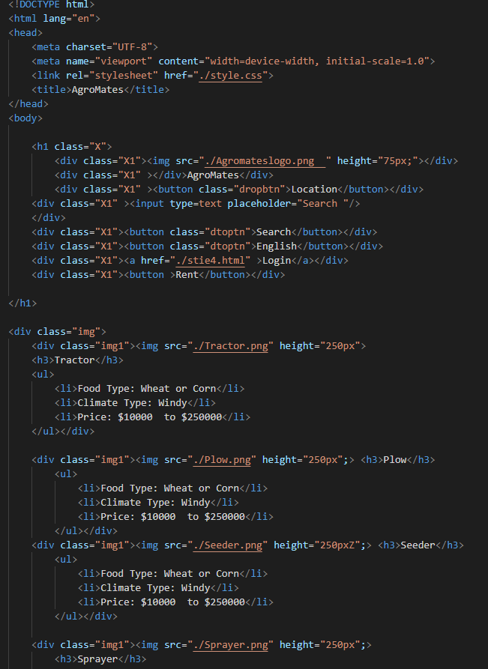
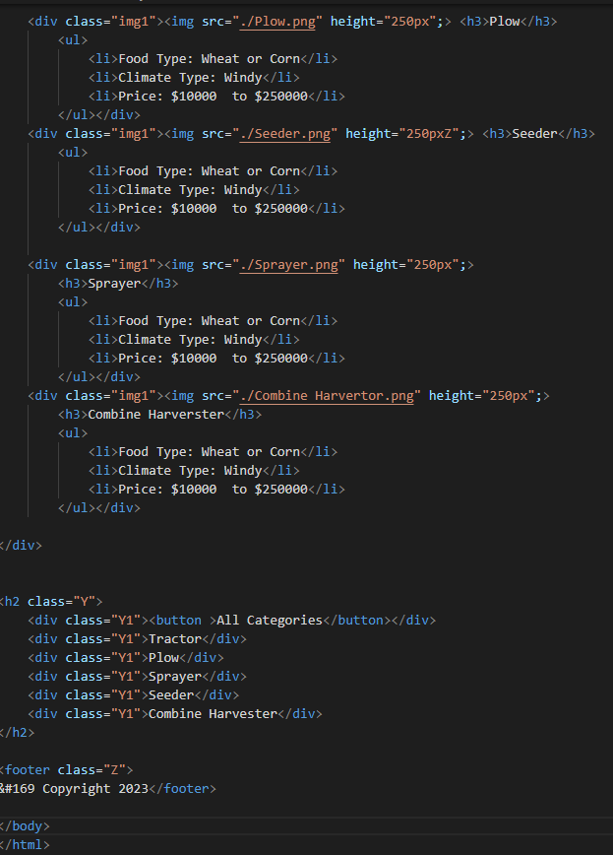
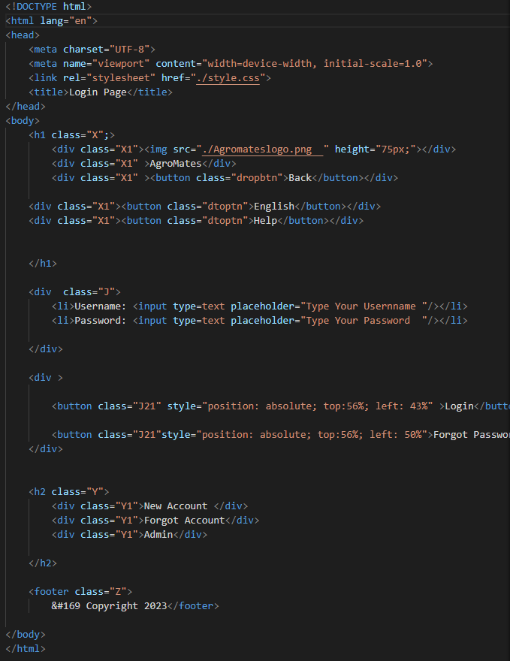
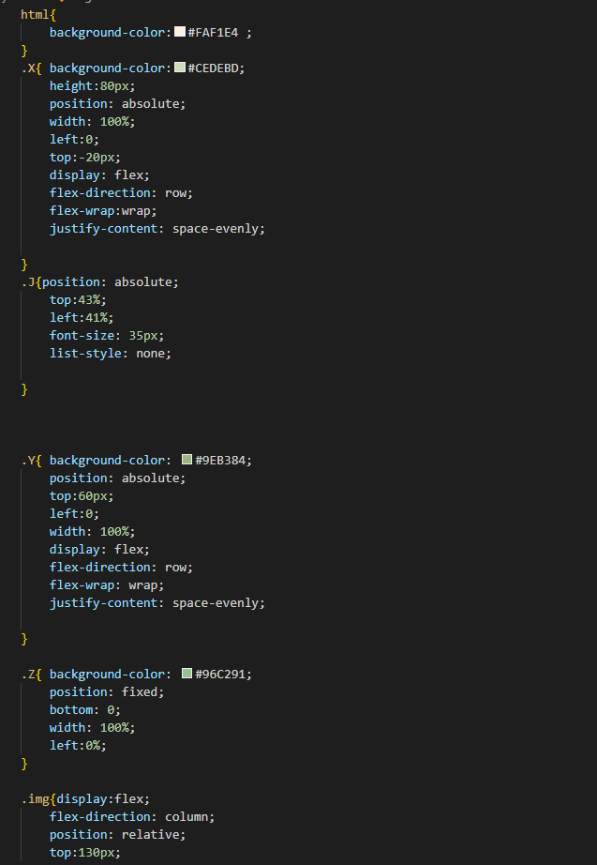
Portal Code: 25% implementation:

Slide 16
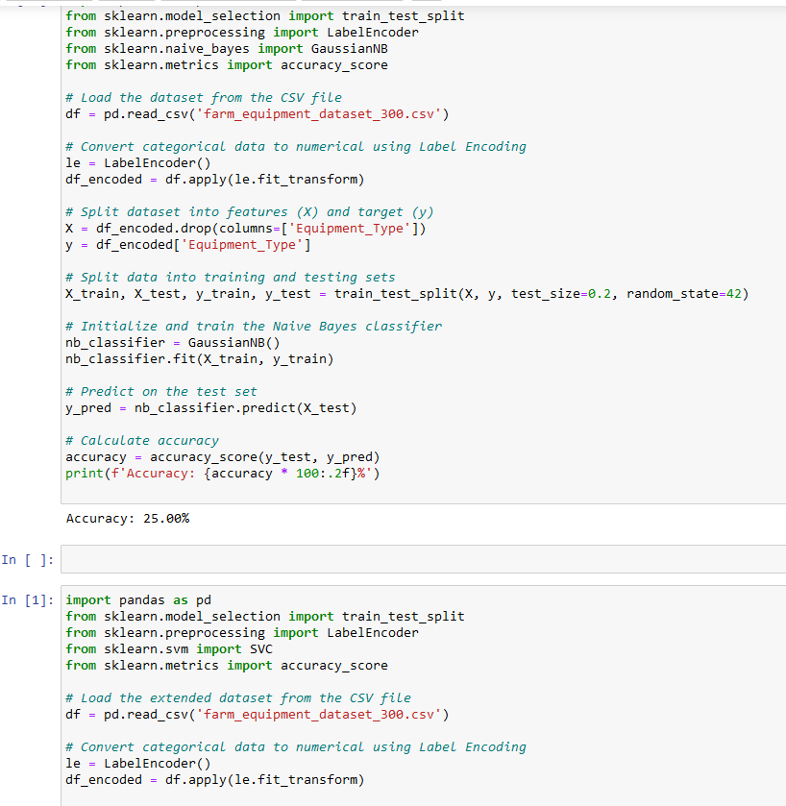
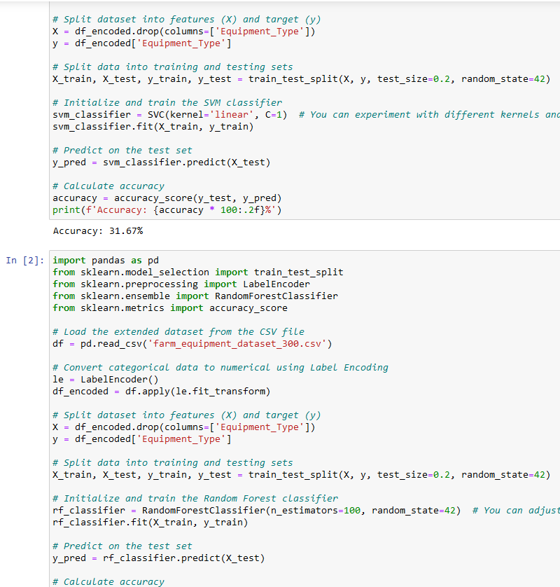
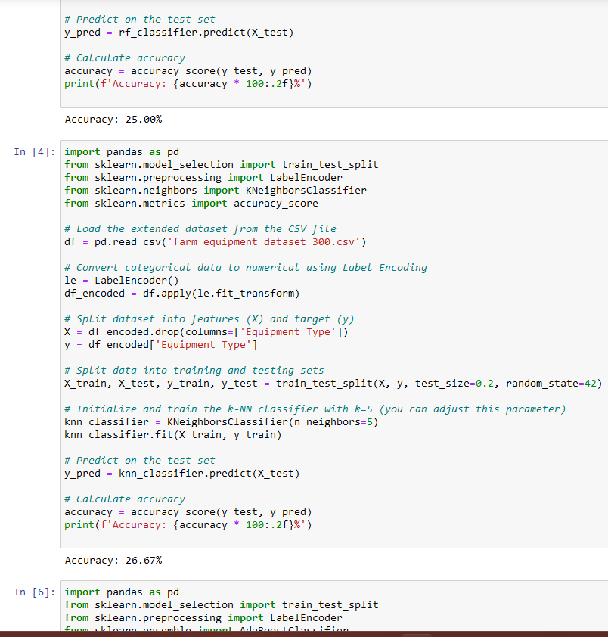
Dataset Code:

Slide 17
Intermediate Results and Discussion

Slide 18
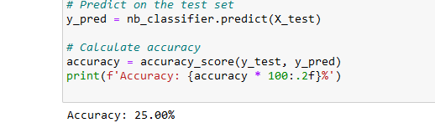
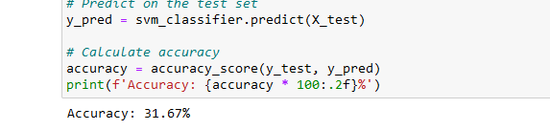
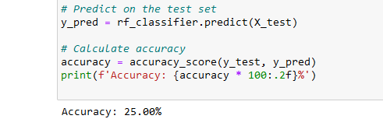
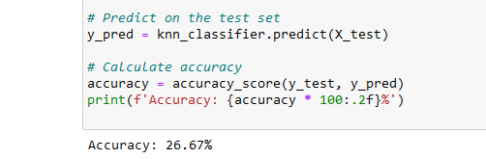
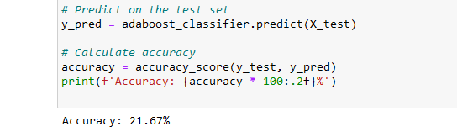
Accuracy Measures:
Naïve Bayes : 25.00%
SVM: 31.67%
Random Forest : 25.00%
K-nearest neighbour: 26.67%
Boosting : 21.67%

Slide 19
New Dataset

Slide 20
New Accuracy Results
Bayes : 87.67%
SVC : 86.30%
Random Forest : 100%
KNearestNeighbour : 80.82%
Adaboost: 73.97%

Slide 21
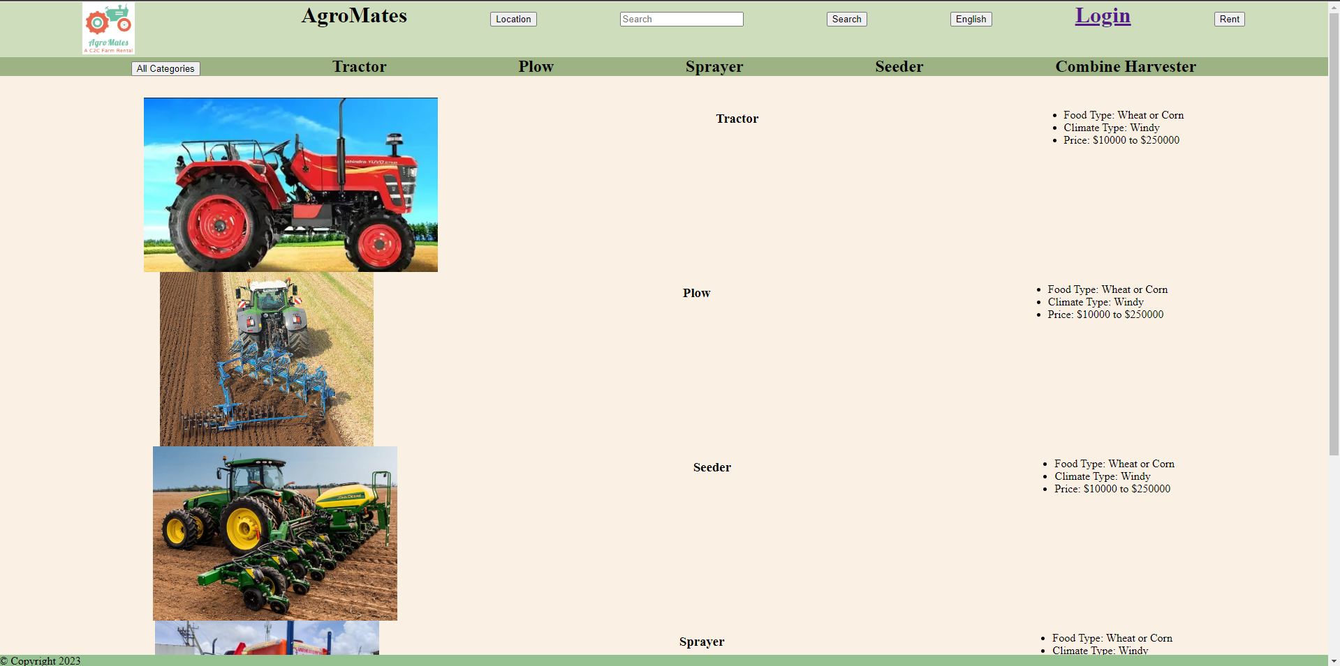
Screenshots

Slide 22
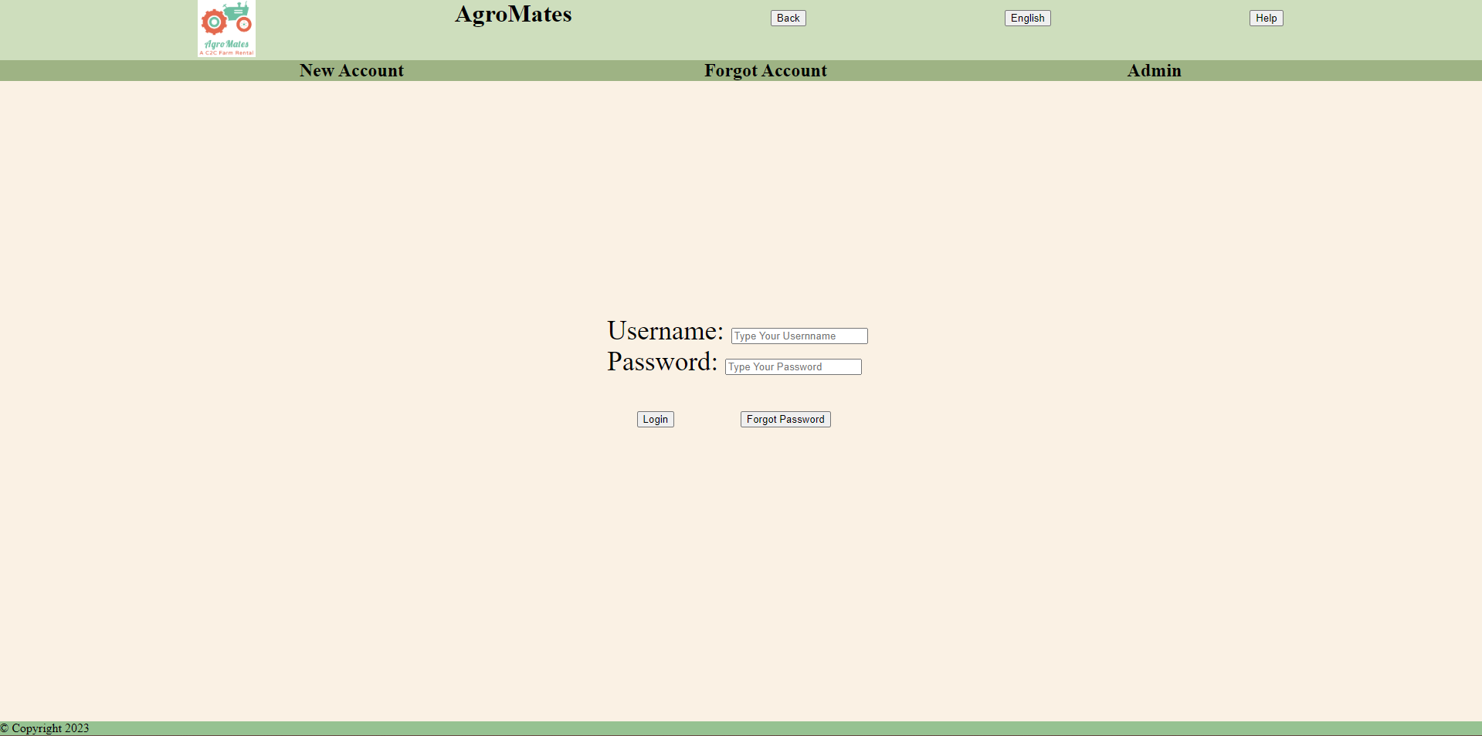

Slide 23

References
[1] R. Sneha Iyer, R. Shruthi, K. Shruthhi and R. Madhumathi, "Spry Farm: A Portal for Connecting Farmers and End Users," 2021 7th International Conference on Advanced Computing and Communication Systems (ICACCS), Coimbatore, India, 2021, pp. 429-433, doi: 10.1109/ICACCS51430.2021.9441815..URL: https://ieeexplore.ieee.org/stamp/stamp.jsp?tp=&arnumber=9441815&isnumber=9441544
[2] Md Iqbal, Vimal Kumar and Vijay Kumar Sharma, “Krishi Portal: Web Based Farmer Help Assistance”, International Journal o f Advanced Science and Technology, vol. 29, pp. 4783-4786, 2007.
[3] Sheetal Bhagwat et al, “Survey Paper on E-Mandi A Market Exchanging Between Farmers and End-user”, International Research Journal o f Engineering and Technology, vol. 6, 2019.

Slide 24
thank you
Ayush Srivastava (RA201100301759) and Hansa Verma (RA2011003010799)

